Slide 1
Apache Maven
IT Academy

Slide 2
Agenda
What is Maven, Project lifecycle
Getting, installing, configuring Maven
POM, GAV, Archetype
The pom.xml contents
dependencies
properties
exclusions
profiles
Some useful plugins

Slide 3
What is Apache Maven
Apache Maven is a build automation tool used primarily for Java projects.
Maven addresses two aspects of building software:
it describes how software is built
it describes its dependencies

Slide 4
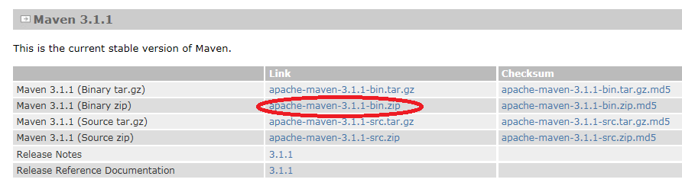
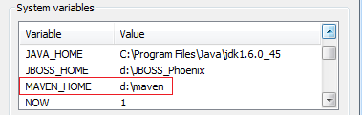
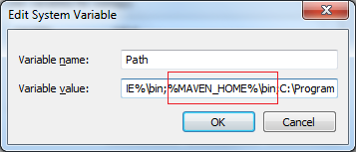
Get it!

Slide 5



Configure
Windows
Settings: %MAVEN_HOME%\conf\settings.xml
Repository Location: UserProfile\.m2\
Linux
Settings: /usr/local/maven/conf/settings.xml
Repository Location: ~/.m2/
Use your own temporary settings for maven:
mvn --settings=[PATH_TO_SETTINGS_FILE]
Adding a Local repository location:
mvn -Dmaven.repo.local=/path/to/local/repo

Slide 6

Create a Simple Project
mvn archetype:generate
-DgroupId=[myGroup]
-DartifactId=[myArtifact]
-Dversion=1.0-SNAPSHOT
-DarchetypeArtifactId=maven-archetype-artifact
OR
mvn archetype:generate

Slide 7
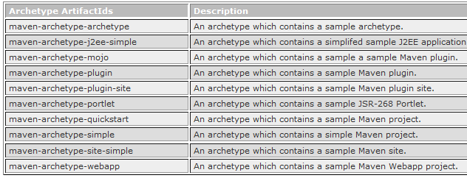

Arche-who? O_o
Archetype is a Maven project templating toolkit.
An archetype is defined as an original pattern or model from which all other things of the same kind are made.

Slide 8
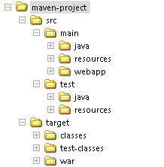

Path Conventions

Slide 9
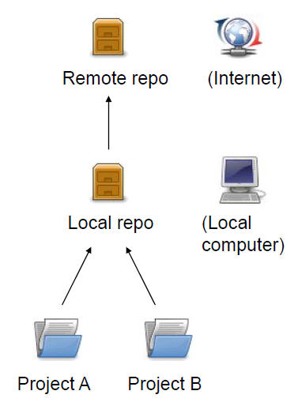
Repositories
Local repository:
copy on local computer which is a cache of the remote downloads;
may contain project-local build artifacts as well;
located in (by default) UserProfile/.m2/repository

Slide 10

Project Object Model (POM)
Describes a project
Name and Version
Artifact Type
Source Code Locations
Dependencies
Plugins
Profiles (alternate build configs.)
Uses XML by default

Slide 11
Project Name (GAV)
Maven uniquely identifies a project using:
groupId: project grouping identifier (no spaces or colons)
usually loosely based on Java package
artfiactId: name of project (no spaces or colons)
version: version of project
format {Major}.{Minor}.{Maintenance}
add -SNAPSHOT to identify in development

Slide 12
Project Name (GAV)
<?xml version="1.0" encoding="UTF-8"?>
<project>
<modelVersion>4.0.0</modelVersion>
<groupId>com.softserve.itacademy</groupId>
<artifactId>HelloMaven</artifactId>
<version>1.0-SNAPSHOT</version>
<name>Maven project</name>
<description>This is a maven project</description>
<packaging>jar</packaging>
<properties>
<java.version>1.8</java.version>
<properties>
</project>

Slide 13

Dependencies
The Dependency is another archive (JAR, ZIP, and so on) which current project needs in order to compile, build, test, and/or to run.
<dependencies>
<dependency>
<groupId>log4j</groupId>
<artifactId>log4j</artifactId>
<version>1.2.16</version>
<scope>compile</scope>
</dependency>
</dependencies>

Slide 14
Dependency Scope
compile (default)
provided (JDK or the container provides it)
runtime (only required for execution, not for compilation)
test (only required for testing, not for normal use)
system (you provide it locally, not looked up in a repo)
<scope>system</scope>
<systemPath>${home}/tools.jar</systemPath>

Slide 15
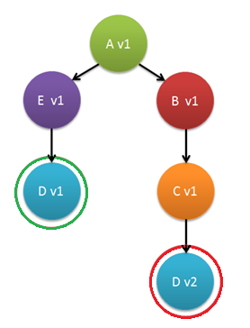
Exclusions
The Maven picks the "nearest definition“ that means that the version used will be the closest one to your project in the tree of dependencies.
<dependency>
<groupId>org.springframework</groupId>
<artifactId>spring-context</artifactId>
<version>5.1.14.RELEASE</version>
<exclusions>
<exclusion>
<groupId>org.hibernate</groupId>
<artifactId>hibernate-validator</artifactId>
</exclusion>
</exclusions>
</dependency>

Slide 16
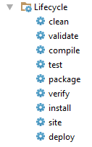

Build Lifecycle
The Build Lifecycle is the process of building and distributing an artifact.
Separate “clean” and “site” lifecycle

Slide 17
Properties
The Properties or variables are useful to keep your Maven pom.xml file more easy to read and maintain.
<properties>
<jdk.version>1.8</jdk.version>
<log4j.version>1.2.16</log4j.version>
</properties>
<dependency>
<groupId>log4j</groupId>
<artifactId>log4j</artifactId> <version>${log4j.version}</version>
</dependency>
mvn install -Dmyproperty = value

Slide 18

Profiles
The Profiles are an alternative set of configuration values which set or override default values.
<profiles>
<profile>
<id>default</id>
<activation>
<activeByDefault>true</activeByDefault>
</activation>
</profile>
</profiles>
mvn install -Pprofilename

Slide 19

Profile Activation
Operating System based:
JDK based:
<activation>
<os>
<name>Windows 7</name>
<family>Windows</family>
<arch>x64</arch>
<version>5.1.2600</version>
</os>
</activation>
<activation>
<jdk>1.4</jdk>
</activation>
<activation>
<jdk>[1.5-1.8)</jdk>
</activation>

Slide 20
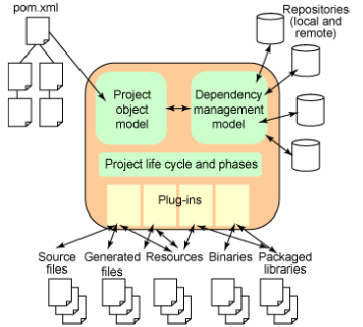

Maven Operation Model
The Plugin-architecture allows usage of plug-ins for various tasks: compile, test, build, deploy, checkstyle, etc.

Slide 21

Plugins
The maven-compiler-plugin has two goals:
compiler:compile and compiler:testCompile
<plugin>
<groupId>org.apache.maven.plugins</groupId>
<artifactId>maven-compiler-plugin</artifactId>
<version>2.0.2</version>
<configuration>
<source>1.8</source>
<target>1.8</target>
<encoding>UTF-8</encoding>
</configuration>
</plugin>

Slide 22
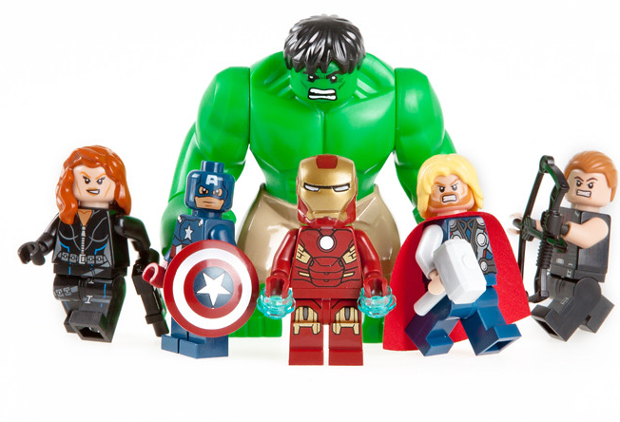
Plugins
The Assembly Plugin for Maven is primarily intended to allow users to aggregate the project output along with its dependencies, modules, site documentation, and other files into a single distributable archive.
<plugin>
<groupId>org.apache.maven.plugins</groupId>
<artifactId>maven-assembly-plugin</artifactId>
<version>3.2.0</version>
<configuration>
<descriptorRefs>
<descriptorRef>jar-with-dependencies</descriptorRef>
</descriptorRefs>
<archive>
<manifest>
<addClasspath>true</addClasspath>
<mainClass>com.softserve.itacademy.App</mainClass>
</manifest>
</archive>
</configuration>
</plugin>
assembly:single

Slide 23

Plugins
The maven-surefire-plugin is used during the test phase of the build lifecycle to execute the unit tests of an application.
<plugin>
<groupId>org.apache.maven.plugins</groupId>
<artifactId>maven-surefire-plugin</artifactId>
<version>2.19.1</version>
<configuration>
<includes>
<include>**/*Test.java</include>
</includes>
<excludes>
<exclude>**/TestToSkip.java</exclude>
</excludes>
</configuration>
</plugin>
surefire:test

Slide 24

Plugins
The maven-checkstyle-plugin generates a report regarding the code style used by the developers.
<plugin> <groupId>org.apache.maven.plugins</groupId> <artifactId>maven-checkstyle-plugin</artifactId> <version>2.17</version> <executions> <execution> <phase>validate</phase> <goals> <goal>check</goal> </goals> </execution> </executions> </plugin>
checkstyle:checkstyle

Slide 25

Plugins
The maven-dependency-plugin provides the capability to manipulate artifacts.
It can copy and/or unpack artifacts from local or remote repositories to a specified location.
mvn dependency:analyze
mvn dependency:tree

Slide 26




Plugins
Generate project files for the most popular IDEs.
Manipulate WAR projects within the popular Servlet containers.
idea:idea
eclipse:eclipse
tomcat7:run
glassfish:deploy

Slide 27
Thanks for attention!
IT Academy

